Slide 1
Causal Bandits: Learning Good Interventions via Causal Inference
Aaradhy Sirothia
Baibhabi Patnaik

Slide 2
Overview
Title: Causal Bandits: Learning Good Interventions via Causal Inference
Authors:
Finnan Lattimore
Tor Lattimore
Mark D.Reid

Slide 3
Background
Scientific process are commonly framed in bandit problems
Medical drug testing, policy testing, …
In this framework, single action from pre-determined set are repeatedly performed in order to evaluate their effectiveness via feedback rewards.
They proposed a generalization of the standard model.
In addition to the rewards, learner can observe the values of covariates drawn from a causal model.

Slide 4
Background: Causal Model
Causal models are commonly used in situations where explicit experiment is difficult.
Example: predicting the effect of changes to childcare subsidies
Causal Inference allows the outcome of an intervention to be predicated without explicitly performing it
Causal model may be given as a graph which shows the causal structure between variables

Slide 5
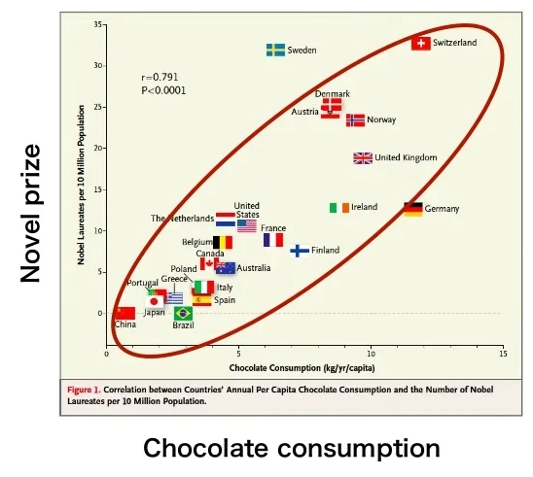
“Correlation does not means causation”
Correlation
The countries which have large amount of chocolate consumption have many novel prizes
Causation
If the amount of chocolate consumption increase the number of novel prize also increase

Slide 6
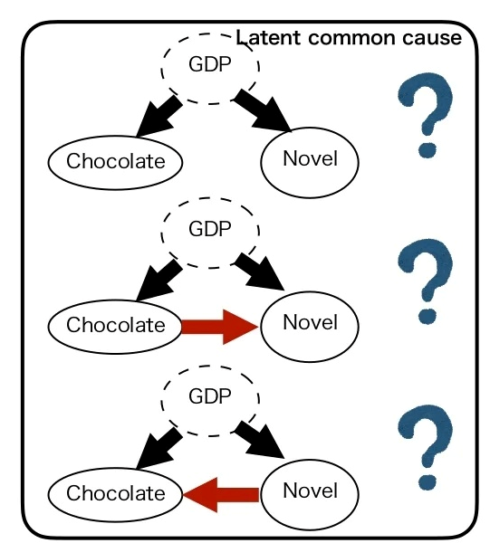
Underlying causal relationship give rise to correlation

Slide 7
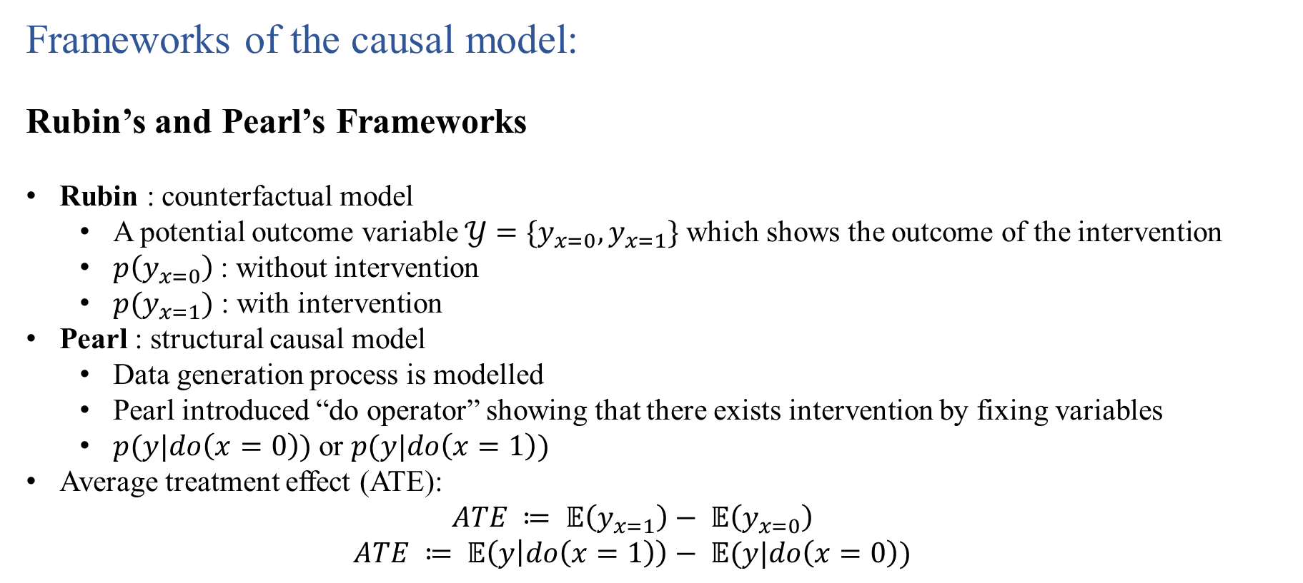
Frameworks of the causal model:
Rubin’s and Pearl’s Frameworks
Rubin : counterfactual model
A potential outcome variable $𝒴=\{y_{x=0}, y_{x=1}\}$ which shows the outcome of the intervention
$p\left(y_{x=0}\right)$: without intervention
$p(y_{x=1})$ : with intervention
Pearl : structural causal model
Data generation process is modelled
Pearl introduced “do operator” showing that there exists intervention by fixing variables
$p(y|do\left(x=0\right))$ or $p(y|do\left(x=1\right))$
Average treatment effect (ATE):
$$ATE ≔ 𝔼\left(y_{x=1}\right)− 𝔼\left(y_{x=0}\right)$$
$$ATE ≔ 𝔼\left(y | do\left(x=1\right)\right)− 𝔼(y|do\left(x=0\right))$$

Slide 8
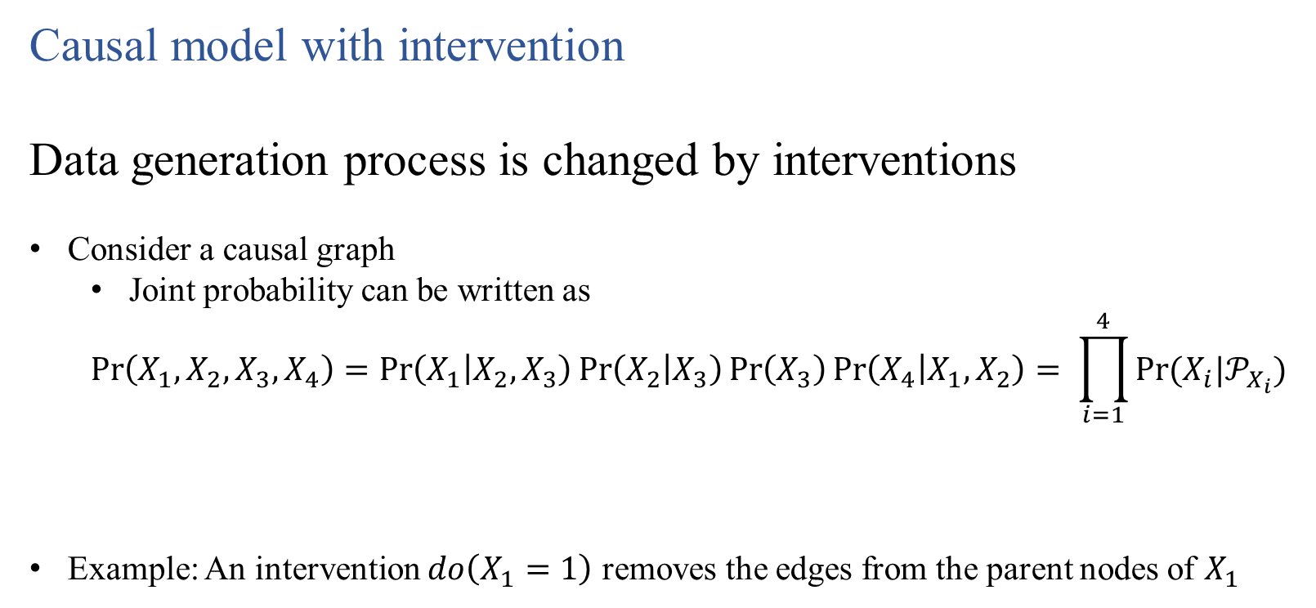
Causal model with intervention
Data generation process is changed by interventions
Consider a causal graph
Joint probability can be written as
$$\operatorname{Pr}\left(X_{1},X_{2},X_{3},X_{4}\right)=\operatorname{Pr}\left(X_{1} | X_{2},X_{3}\right)\operatorname{Pr}\left(X_{2} | X_{3}\right)\operatorname{Pr}\left(X_{3}\right)\operatorname{Pr}\left(X_{4} | X_{1},X_{2}\right)= \prod_{i=1}^{4}{Pr⁡(X_{i}|𝒫_{X_{i}})}$$
Example: An intervention $do\left(X_{1}=1\right)$ removes the edges from the parent nodes of $X_{1}$
X₂
X₁
X₄
X₃
X₂
X₁
X₄
X₃

Slide 9
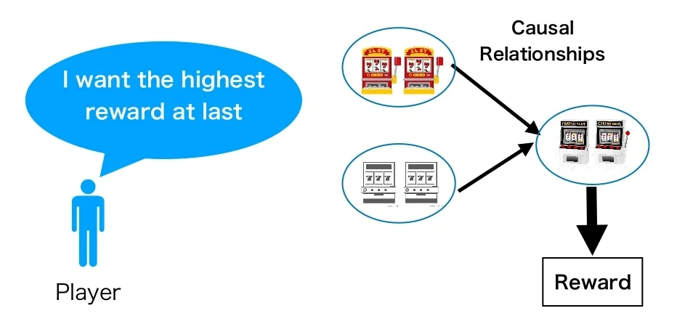
Causal Bandit Problem
A player tries to find the best action which has the highest expected reward in the limited number of trials

Slide 10

Example of causal bandit problem
Soil
Temp
Moisture
Soil
Objective: Optimise the yield of crop
Problem: How might the farmer best experiment to identify the single, highest
yielding intervention in a limited number of seasons?
Limitations: Performing explicit experiment is difficult
Yield

Slide 11


Example:
The farmer wants to know the intervention to maximize the crop yield
Season 1
Season 2
Season 3
Season T
Intervention: Fixing a variable
Temperature: Low
Nutrient: Low
Moisture: High
Temperature: High
Nutrient: Low
Moisture: High
Temperature: Low
Nutrient: High
Moisture: High
Temperature: ?
Nutrient: ?
Moisture: ?
How to intervene?
Reward: High
Reward: Low
Reward: Low

Slide 12
Notation and problem setting
Notation
Problem Setting
Assumed scenario of causal bandit problem
Input and output
Relation to classical multi-armed bandit problem

Slide 13
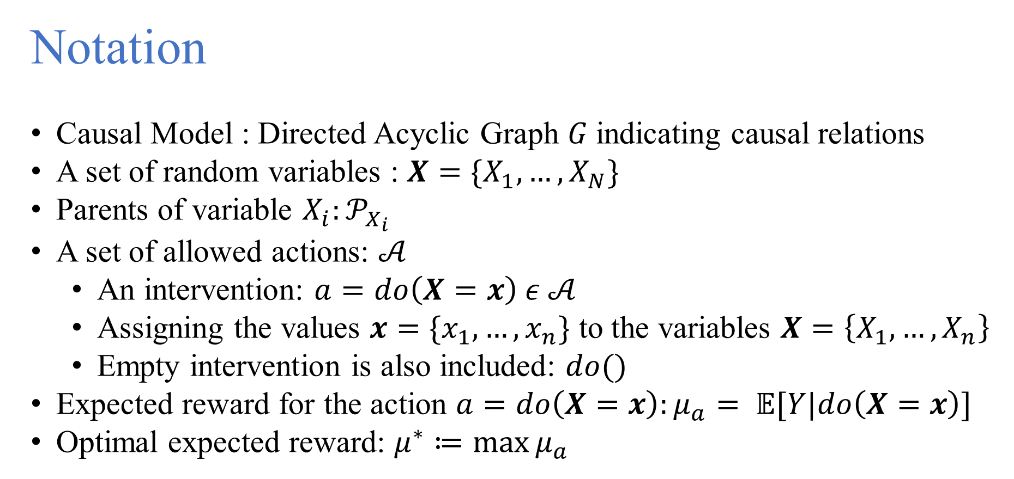
Notation
Causal Model : Directed Acyclic Graph $G$indicating causal relations
A set of random variables : $X=\{X_{1},…,X_{N}\}$
Parents of variable $X_{i}:𝒫_{X_{i}}$
A set of allowed actions: $𝒜$
An intervention: $a=do\left(X=x\right) ε 𝒜$
Assigning the values $x=\{x_{1},…, x_{n}\}$ to the variables $X=\left\{X_{1}, …, X_{n}\right\}$
Empty intervention is also included: $do()$
Expected reward for the action $a=do\left(X=x\right):μ_{a}= 𝔼[Y|do\left(X=x\right)]$
Optimal expected reward: $μ^{∗}≔\max{μ_{a}}$

Slide 14
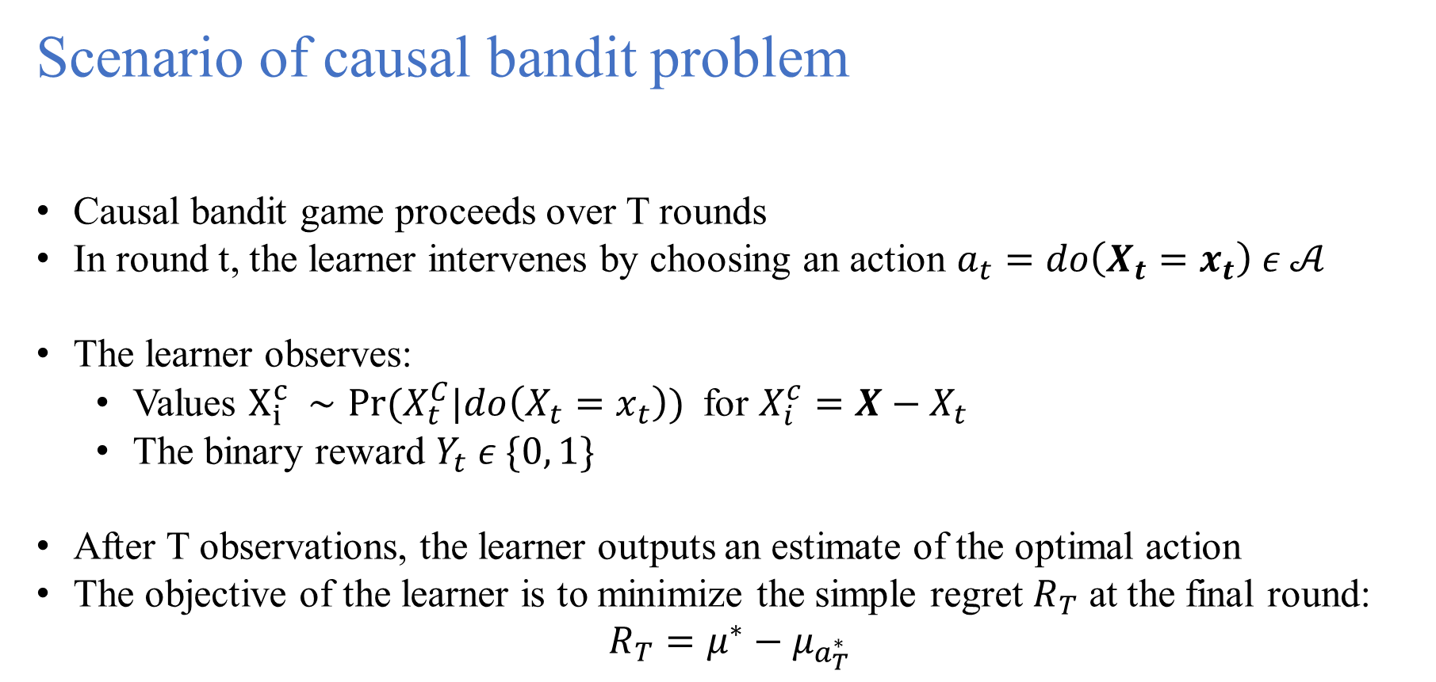
Scenario of causal bandit problem
Causal bandit game proceeds over T rounds
In round t, the learner intervenes by choosing an action $a_{t}=do\left(X_{t}=x_{t}\right) ε 𝒜$
The learner observes:
Values $X_{i}^{c} ∼Pr⁡(X_{t}^{C}|do\left(X_{t}=x_{t}\right))$ for $X_{i}^{c}=X−X_{t}$
The binary reward $Y_{t} ε \{0, 1\}$
After T observations, the learner outputs an estimate of the optimal action
The objective of the learner is to minimize the simple regret $R_{T}$ at the final round:
$$R_{T}=μ^{∗}−μ_{a_{T}^{∗}}$$

Slide 15
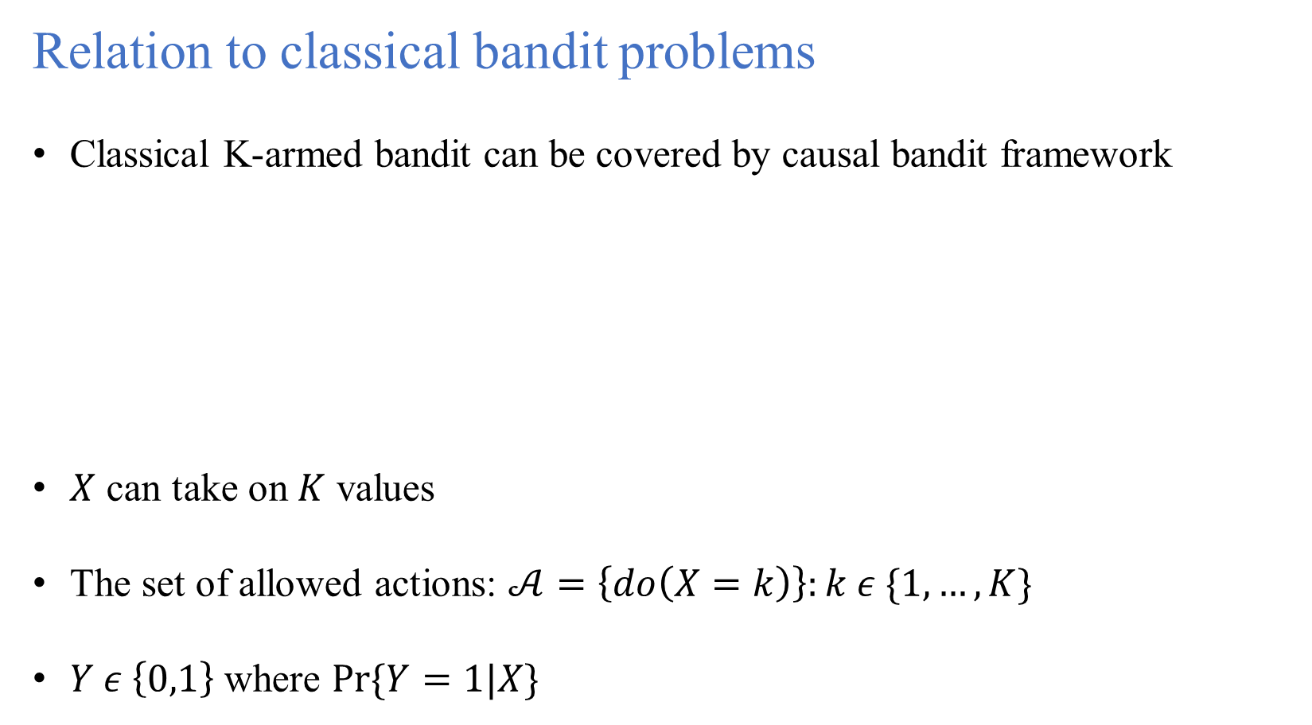
Relation to classical bandit problems
Classical K-armed bandit can be covered by causal bandit framework
$X$ can take on $K$ values
The set of allowed actions: $𝒜=\left\{do\left(X=k\right)\right\}:k ε \{1, …, K\}$
$Y ε \left\{0,1\right\}$ where $Pr⁡\{Y=1|X\}$
X
Y

Slide 16
Proposed Methods
A special case of causal bandit problem
An algorithm for the special case: Parallel Bandit
General case of the causal bandit problem
An algorithm for the general problem: General Graph

Slide 17
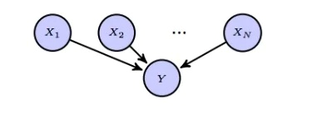
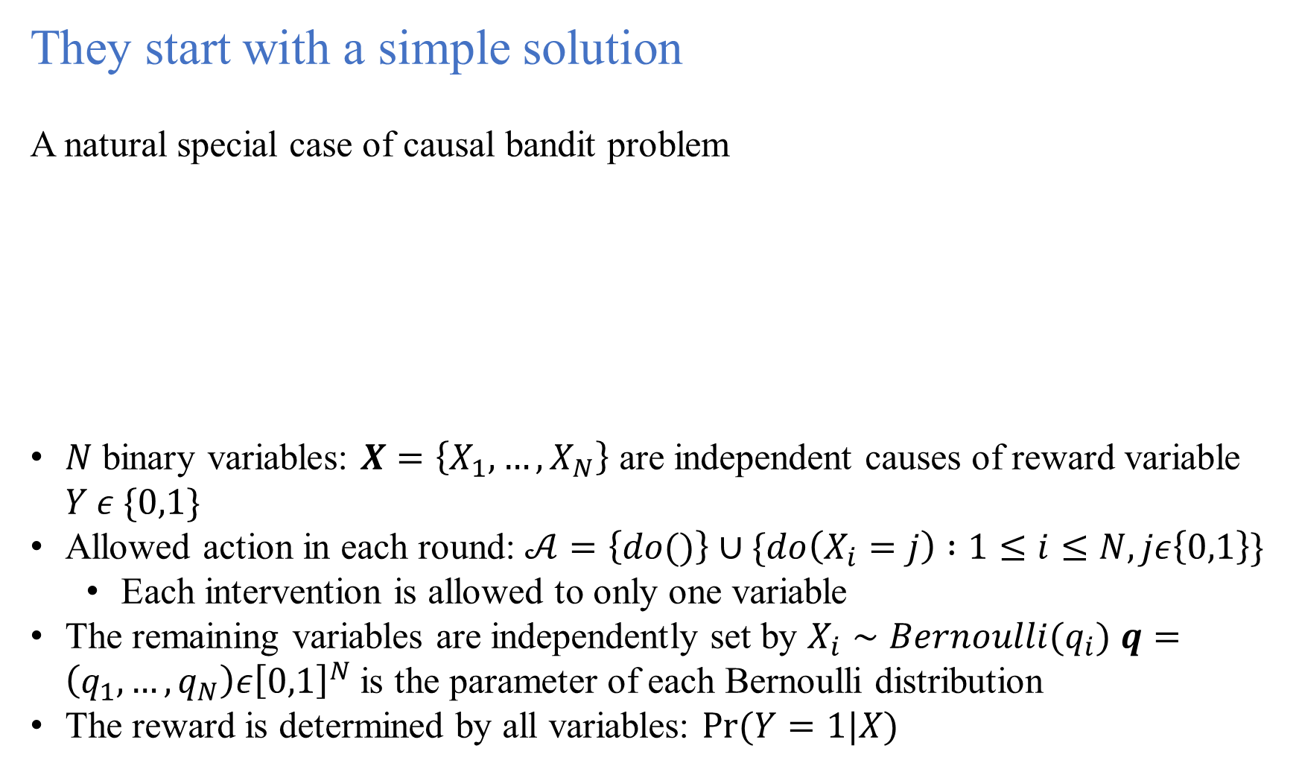
They start with a simple solution
A natural special case of causal bandit problem
$N$ binary variables: $X=\left\{X_{1},…,X_{N}\right\}$ are independent causes of reward variable $Y ε \{0,1\}$
Allowed action in each round: $𝒜=\left\{do()\right\}∪\{do\left(X_{i}=j\right) :1≤i≤N, jε\left\{0,1\right\}\}$
Each intervention is allowed to only one variable
The remaining variables are independently set by $X_{i}∼Bernoulli(q_{i})$ $q=\left(q_{1},…,q_{N}\right)ε{\left[0,1\right]}^{N}$ is the parameter of each Bernoulli distribution
The reward is determined by all variables: $Pr⁡(Y=1|X)$

Slide 18
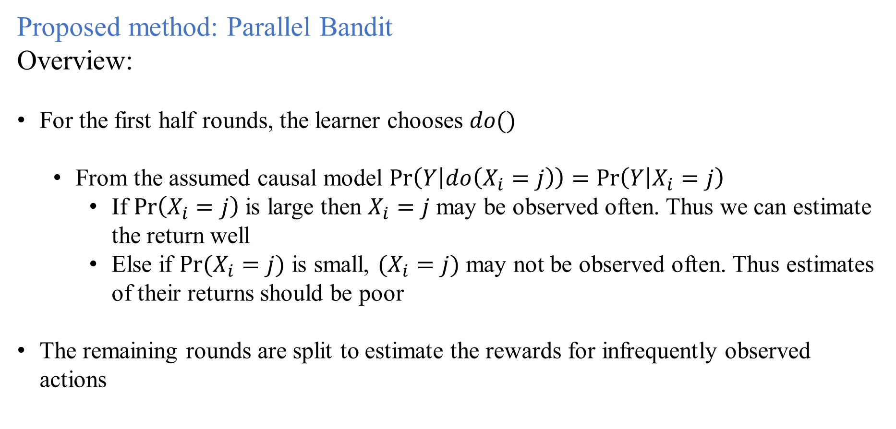
Proposed method: Parallel Bandit
Overview:
For the first half rounds, the learner chooses $do()$
From the assumed causal model $\operatorname{Pr}\left(Y | do\left(X_{i}=j\right)\right)=\operatorname{Pr}\left(Y | X_{i}=j\right)$
If $\operatorname{Pr}\left(X_{i}=j\right)$ is large then $X_{i}=j$ may be observed often. Thus we can estimate the return well
Else if $Pr⁡(X_{i}=j)$ is small, $(X_{i}=j)$ may not be observed often. Thus estimates of their returns should be poor
The remaining rounds are split to estimate the rewards for infrequently observed actions

Slide 19
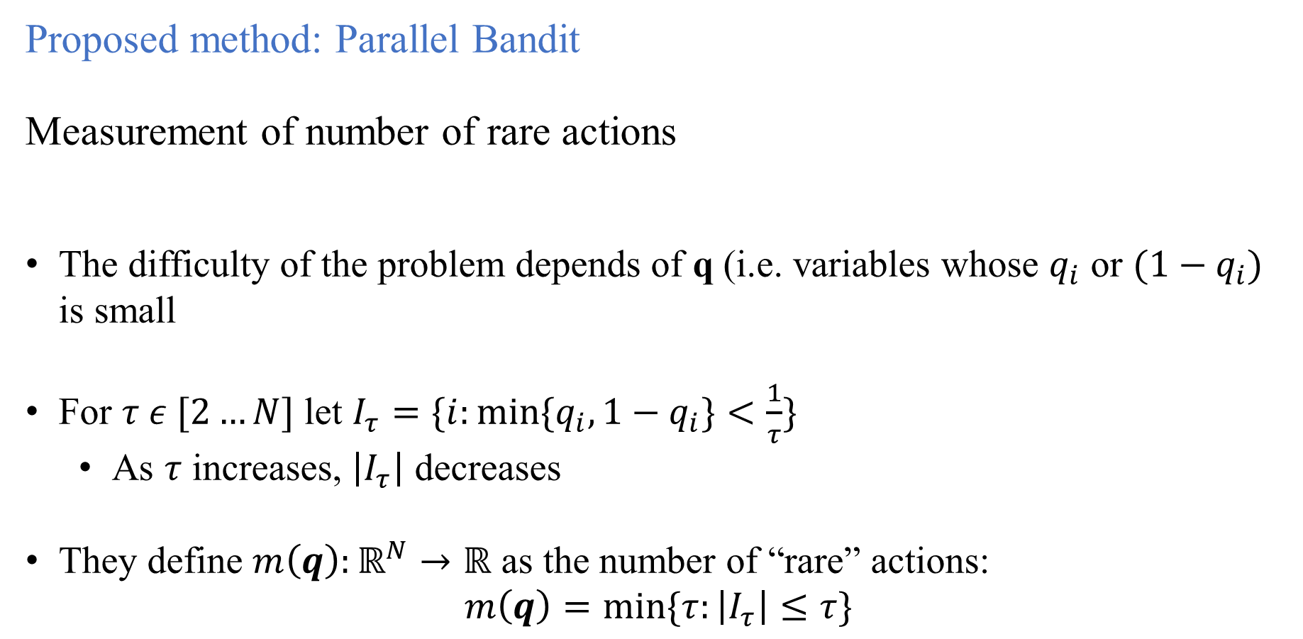
Proposed method: Parallel Bandit
Measurement of number of rare actions
The difficulty of the problem depends of q (i.e. variables whose $q_{i}$ or $(1−q_{i})$ is small
For $τ ε [2…N]$ let $I_{τ}=\{i:\min{{\{q}_{i},1−q_{i}\}<\frac{1}{τ}\}}$
As $τ$ increases, $\left|I_{τ}\right|$ decreases
They define $m\left(q\right):ℝ^{N}→ℝ$ as the number of “rare” actions:
$$m\left(q\right)=\min{\{τ:\left|I_{τ}\right|≤τ\}}$$

Slide 20
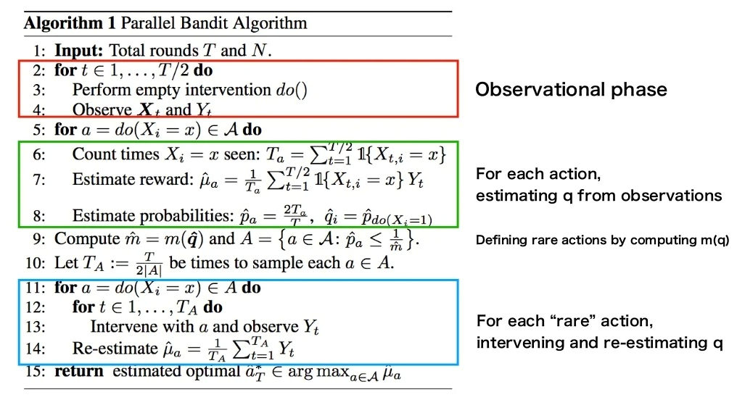

Slide 21
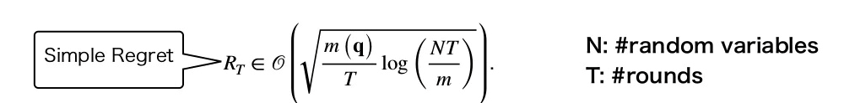
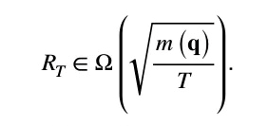
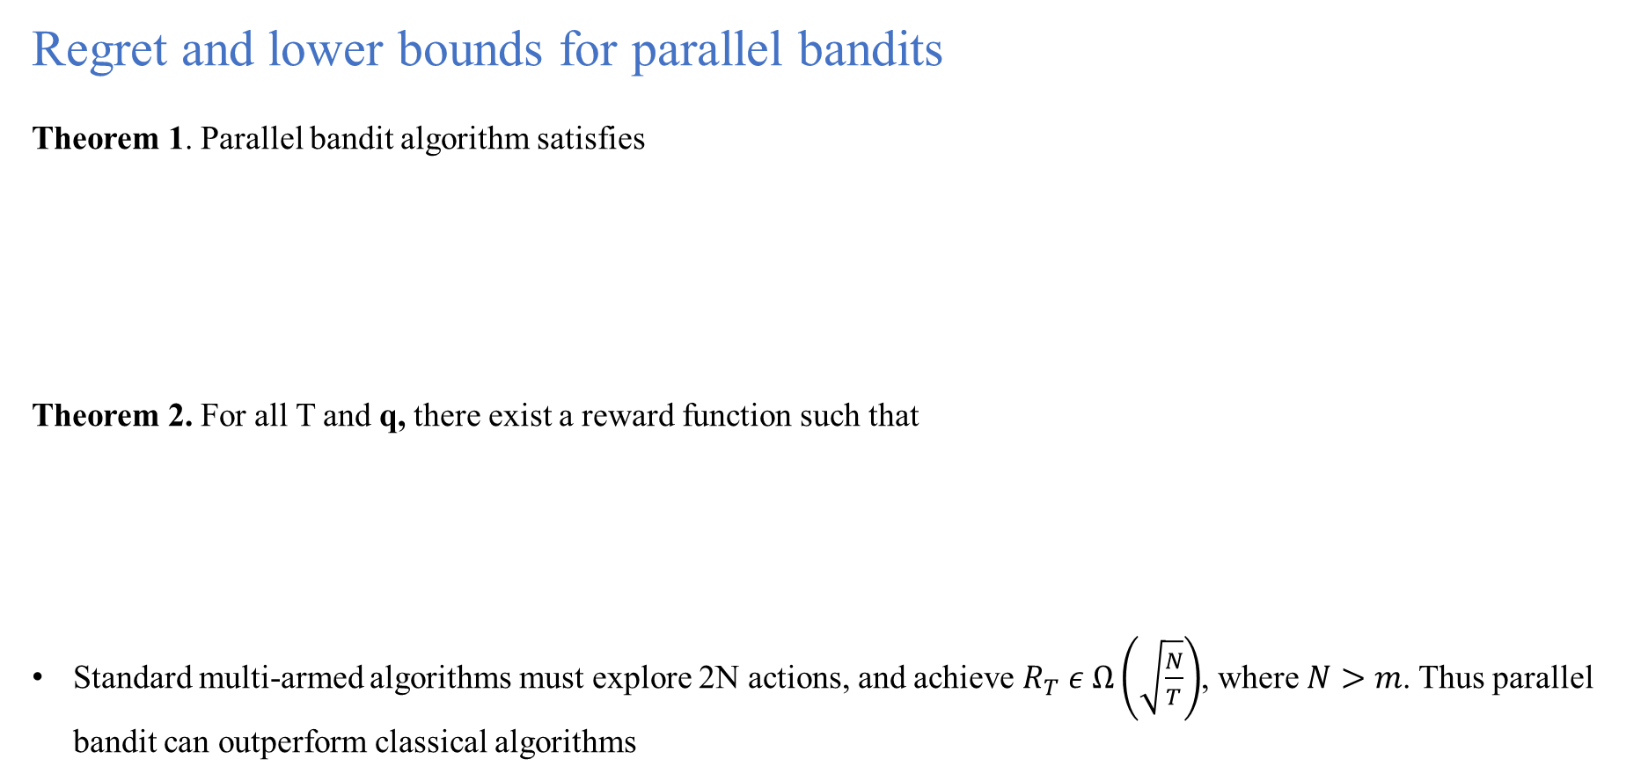
Regret and lower bounds for parallel bandits
Theorem 1. Parallel bandit algorithm satisfies
Theorem 2. For all T and q, there exist a reward function such that
Standard multi-armed algorithms must explore 2N actions, and achieve $R_{T} ε Ω\left(\sqrt{\frac{N}{T}}\right)$, where $N>m$. Thus parallel bandit can outperform classical algorithms

Slide 22
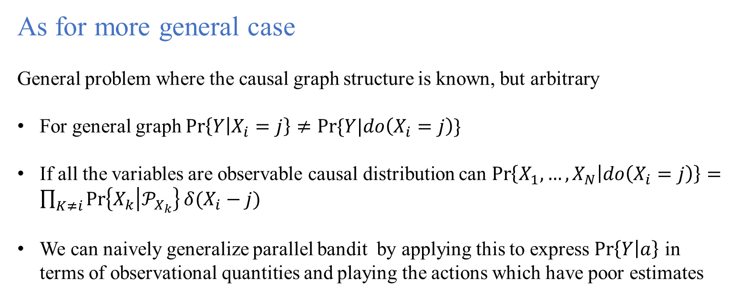
As for more general case
General problem where the causal graph structure is known, but arbitrary
For general graph $\operatorname{Pr}\left\{Y | X_{i}=j\right\}≠Pr⁡\{Y|do\left(X_{i}=j\right)\}$
If all the variables are observable causal distribution can $\operatorname{Pr}\left\{X_{1},…,X_{N} | do\left(X_{i}=j\right)\right\}=\prod_{K≠i}{\operatorname{Pr}\left\{X_{k} | 𝒫_{X_{k}}\right\}δ(X_{i}−j)}$
We can naively generalize parallel bandit by applying this to express $\operatorname{Pr}\left\{Y | a\right\}$ in terms of observational quantities and playing the actions which have poor estimates

Slide 23

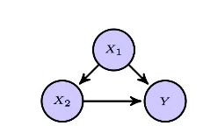
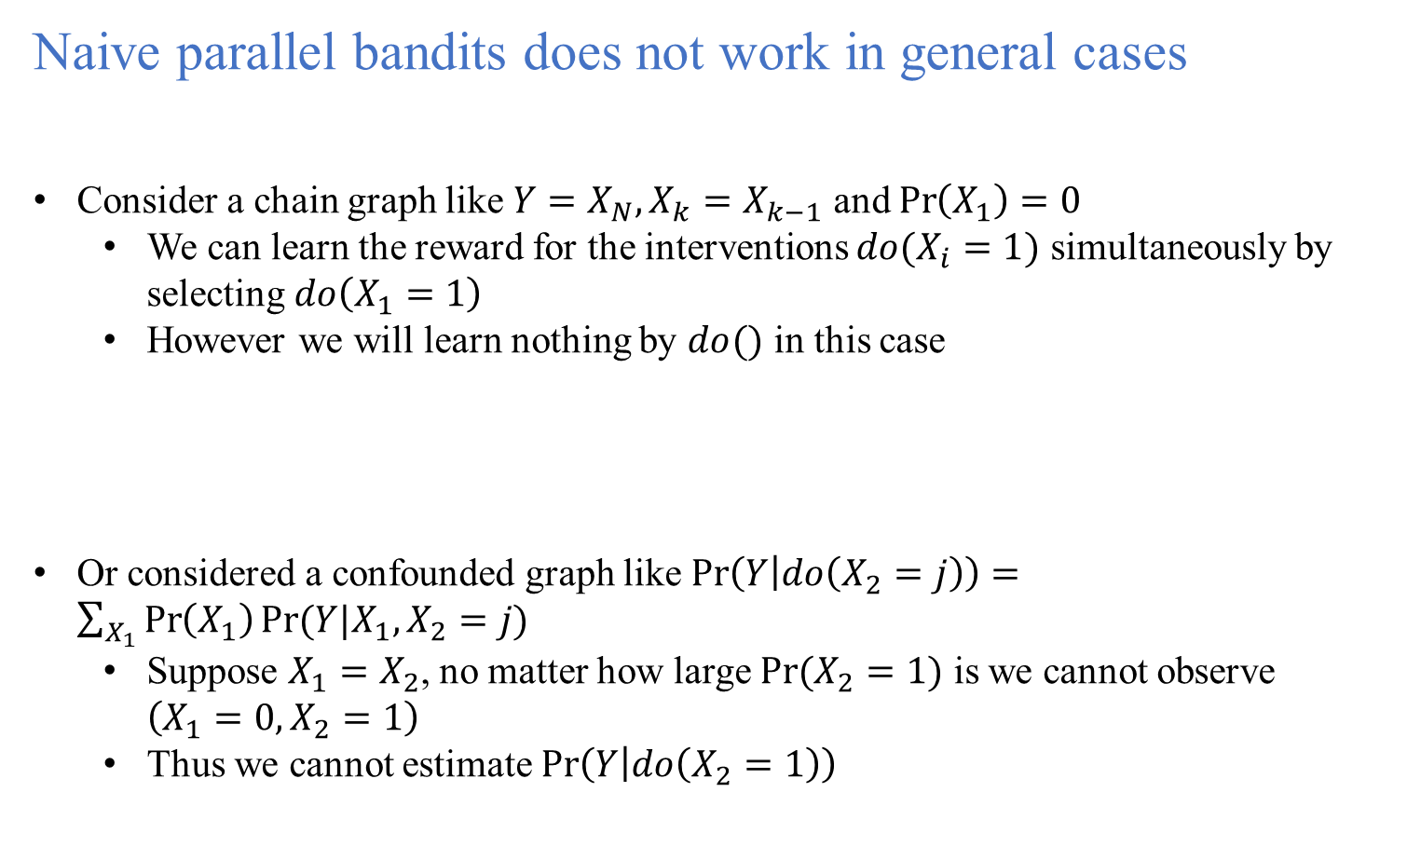
Naive parallel bandits does not work in general cases
Consider a chain graph like $Y=X_{N}, X_{k}=X_{k−1}$ and $\operatorname{Pr}\left(X_{1}\right)=0$
We can learn the reward for the interventions $do(X_{i}=1)$ simultaneously by selecting $do\left(X_{1}=1\right)$
However we will learn nothing by $do()$ in this case
Or considered a confounded graph like $\operatorname{Pr}\left(Y | do\left(X_{2}=j\right)\right)=\sum_{X_{1}}{\operatorname{Pr}\left(X_{1}\right)Pr⁡(Y|X_{1},X_{2}=j)}$
Suppose $X_{1}=X_{2}$, no matter how large $Pr⁡(X_{2}=1)$ is we cannot observe $\left(X_{1}=0, X_{2}=1\right)$
Thus we cannot estimate $\operatorname{Pr}\left(Y | do\left(X_{2}=1\right)\right)$

Slide 24
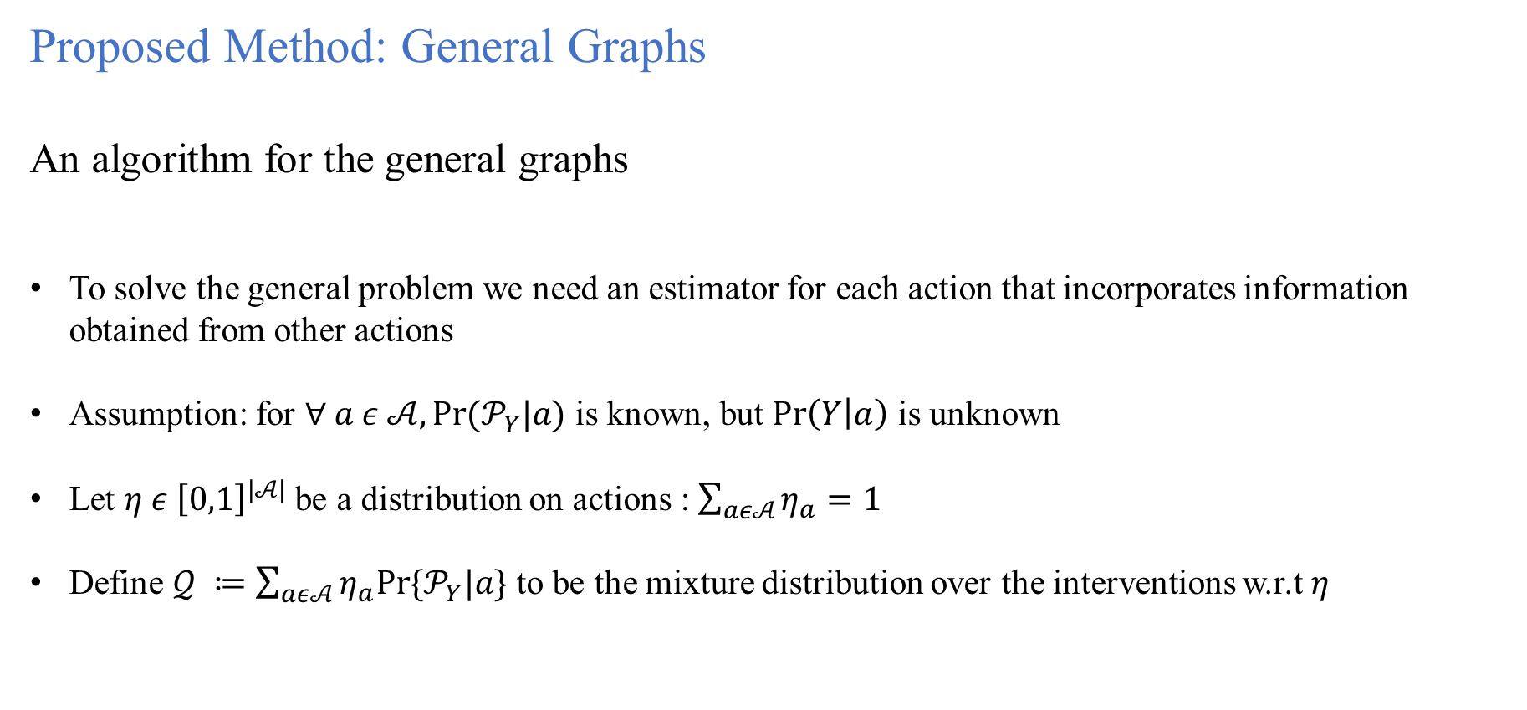
Proposed Method: General Graphs
An algorithm for the general graphs
To solve the general problem we need an estimator for each action that incorporates information obtained from other actions
Assumption: for $∀ a ε 𝒜, Pr⁡(𝒫_{Y}|a)$ is known, but $\operatorname{Pr}\left(Y | a\right)$ is unknown
Let $η ε {\left[0,1\right]}^{|𝒜|}$be a distribution on actions : $\sum_{aε𝒜}{η_{a}=1}$
Define $𝒬 ≔\sum_{aε𝒜}{η_{a}Pr⁡\{𝒫_{Y}|a\}}$ to be the mixture distribution over the interventions w.r.t $η$

Slide 25
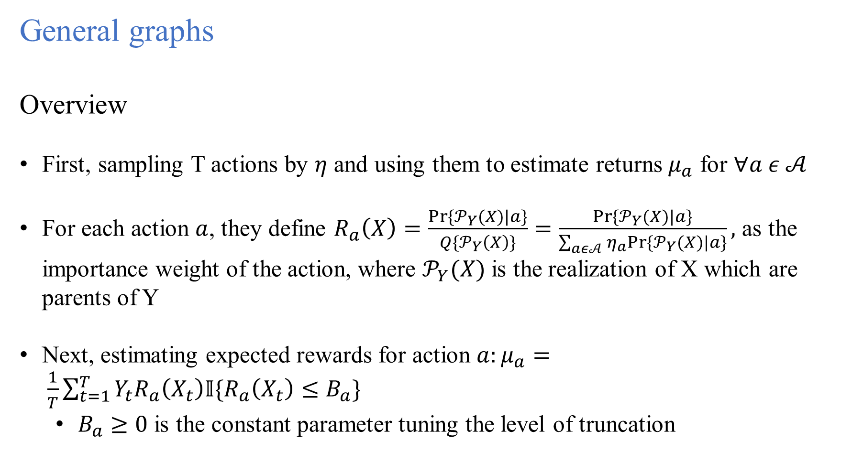
General graphs
Overview
First, sampling T actions by $η$ and using them to estimate returns $μ_{a}$ for $∀a ε 𝒜$
For each action $a$, they define $R_{a}\left(X\right)=\frac{Pr⁡\{𝒫_{Y}(X)|a\}}{Q\{𝒫_{Y}\left(X\right)\}}=\frac{Pr⁡\{𝒫_{Y}(X)|a\}}{\sum_{aε𝒜}{η_{a}Pr⁡\{𝒫_{Y}(X)|a\}}},$ as the importance weight of the action, where $𝒫_{Y}(X)$ is the realization of X which are parents of Y
Next, estimating expected rewards for action $a:μ_{a}= \frac{1}{T}\sum_{t=1}^{T}{Y_{t}R_{a}\left(X_{t}\right)𝕀\{R_{a}\left(X_{t}\right)≤B_{a}\}}$
$B_{a}≥0$ is the constant parameter tuning the level of truncation

Slide 26
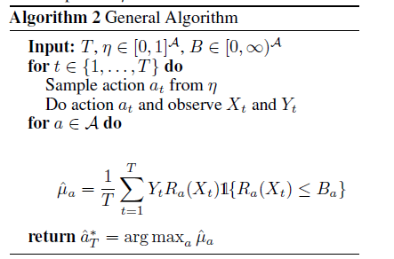
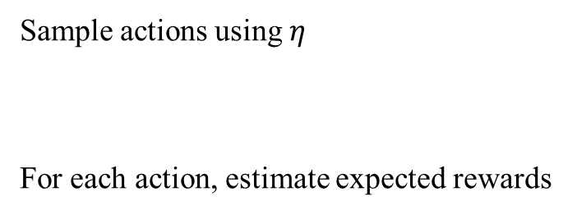
General graphs
Sample actions using $η$
For each action, estimate expected rewards

Slide 27
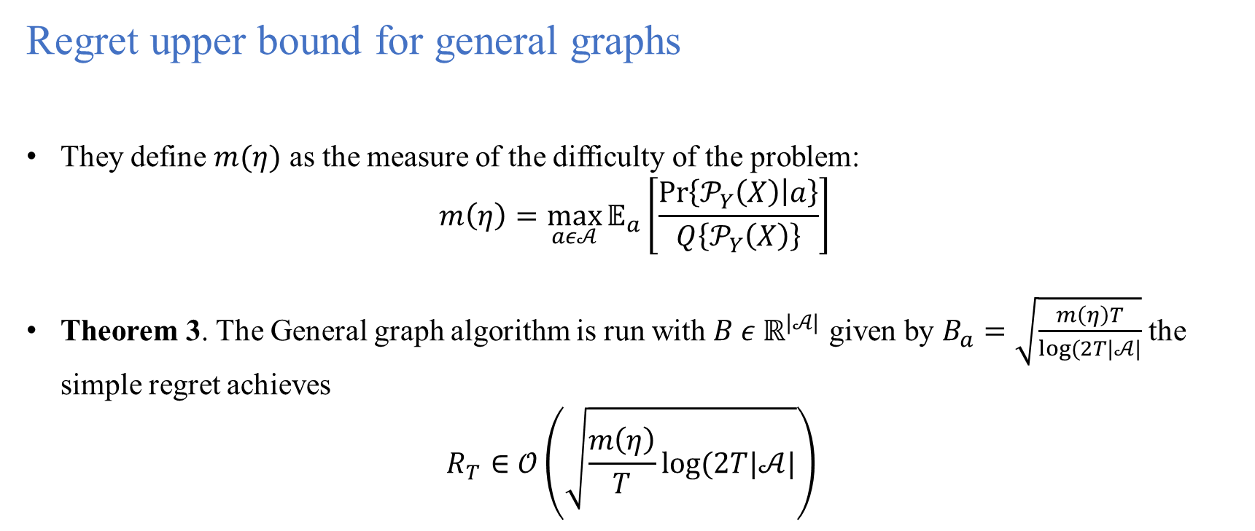
Regret upper bound for general graphs
They define $m(η)$ as the measure of the difficulty of the problem:
$$m\left(η\right)=\max_{aε𝒜}{𝔼_{a}\left[\frac{\operatorname{Pr}\left\{𝒫_{Y}\left(X\right) | a\right\}}{Q\left\{𝒫_{Y}\left(X\right)\right\}}\right]}$$
Theorem 3. The General graph algorithm is run with $B ε ℝ^{|𝒜|}$ given by $B_{a}=\sqrt{\frac{m\left(η\right)T}{log⁡(2T|𝒜|}}$ the simple regret achieves
$$R_{T}∈𝒪\left(\sqrt{\frac{m\left(η\right)}{T}log⁡(2T|𝒜|}\right)$$

Slide 28
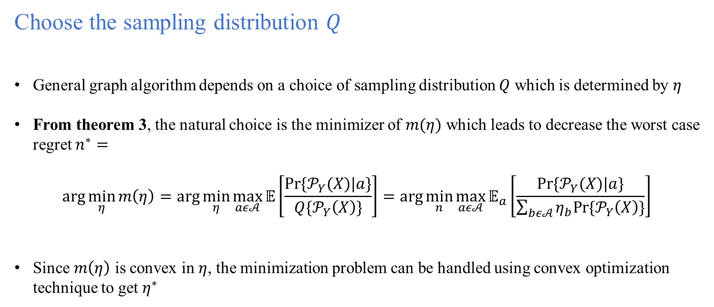
Choose the sampling distribution $Q$
General graph algorithm depends on a choice of sampling distribution $Q$ which is determined by $η$
From theorem 3, the natural choice is the minimizer of $m(η)$ which leads to decrease the worst case regret $n^{∗}=$
$$\arg{\min_{η}{m\left(η\right)=\arg{\min_{η}{\max_{aε𝒜}{𝔼\left[\frac{Pr⁡\{𝒫_{Y}(X)|a\}}{Q\{𝒫_{Y}\left(X\right)\}}\right]=\arg{\min_{n}{\max_{aε𝒜}{𝔼_{a}\left[\frac{Pr⁡\{𝒫_{Y}(X)|a\}}{\sum_{bε𝒜}{η_{b}Pr⁡\{𝒫_{Y}\left(X\right)\}}}\right]}}}}}} }}$$
Since $m\left(η\right)$ is convex in $η$, the minimization problem can be handled using convex optimization technique to get $η^{∗}$

Slide 29
Experiment:
Comparing with classical algorithm
Comparing methods
Successive Reject algorithm
Repeatedly sample the worst arms
Thompson Sampling: stochastic method
Thompson Sampling for arm selection
Upper Confidence Bound (UCB): deterministic method
Calculate upper confidence bound of the estimated rewards

Slide 30
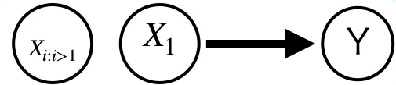
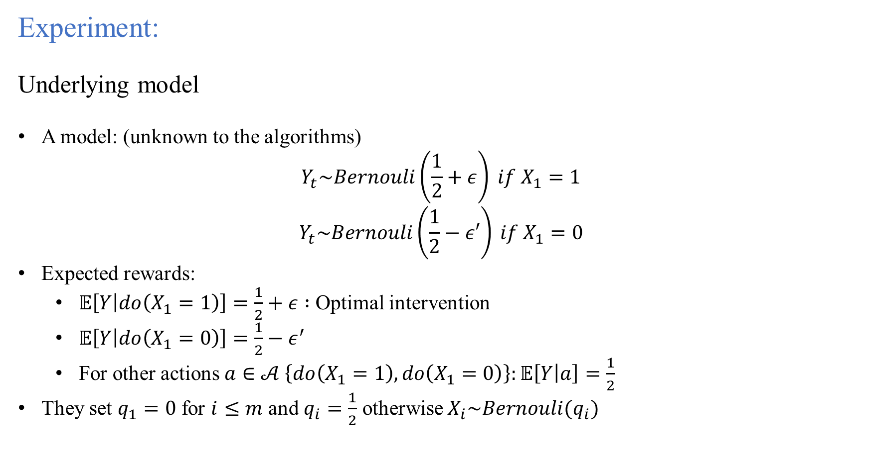
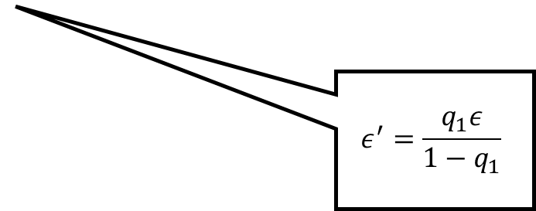
Experiment:
Underlying model
A model: (unknown to the algorithms)
$$Y_{t}\sim Bernouli\left(\frac{1}{2}+ε\right) if X_{1}=1$$
$$Y_{t}\sim Bernouli\left(\frac{1}{2}−ε′\right) if X_{1}=0$$
Expected rewards:
$𝔼\left[Y | do\left(X_{1}=1\right)\right]=\frac{1}{2}+ε :$ Optimal intervention
$𝔼\left[Y | do\left(X_{1}=0\right)\right]=\frac{1}{2}−ε^{′}$
For other actions $a∈𝒜 \left\{do\left(X_{1}=1\right), do\left(X_{1}=0\right)\right\}:𝔼\left[Y | a\right]=\frac{1}{2}$
They set $q_{1}=0$ for $i≤m$ and $q_{i}=\frac{1}{2}$ otherwise $X_{i}\sim Bernouli(q_{i})$
$$ε^{′}=\frac{q_{1}ε}{1−q_{1}}$$

Slide 31
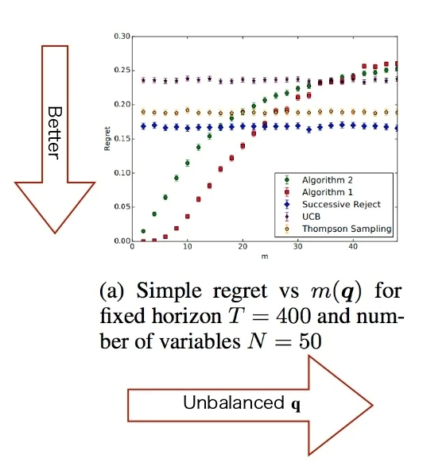
Experiment result:
Fix #variables N and #total rounds T
As m approaches N, the causal algorithm obtain less knowledge of the structure

Slide 32
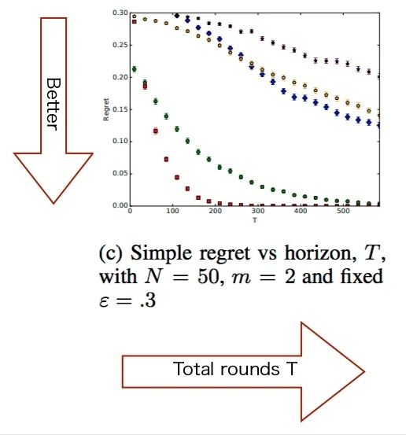
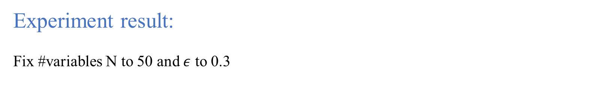
Experiment result:
Fix #variables N to 50 and $ε$ to 0.3
For sufficiently large T, the regret decays exponentially
Causal algorithm have observed a greater effective number of samples for a given T

Slide 33
Summary and future work:
Summary
They define causal bandit problem, the new bandit problem under causal relations among variables
They propose algorithms for the causal bandit problem and analyse the simple regret bounds.
Future work
Finding an algorithm that only requires the causal graph and lower bounds for its simple regret in the general case

Slide 34
Thank You!!

